Slide 1
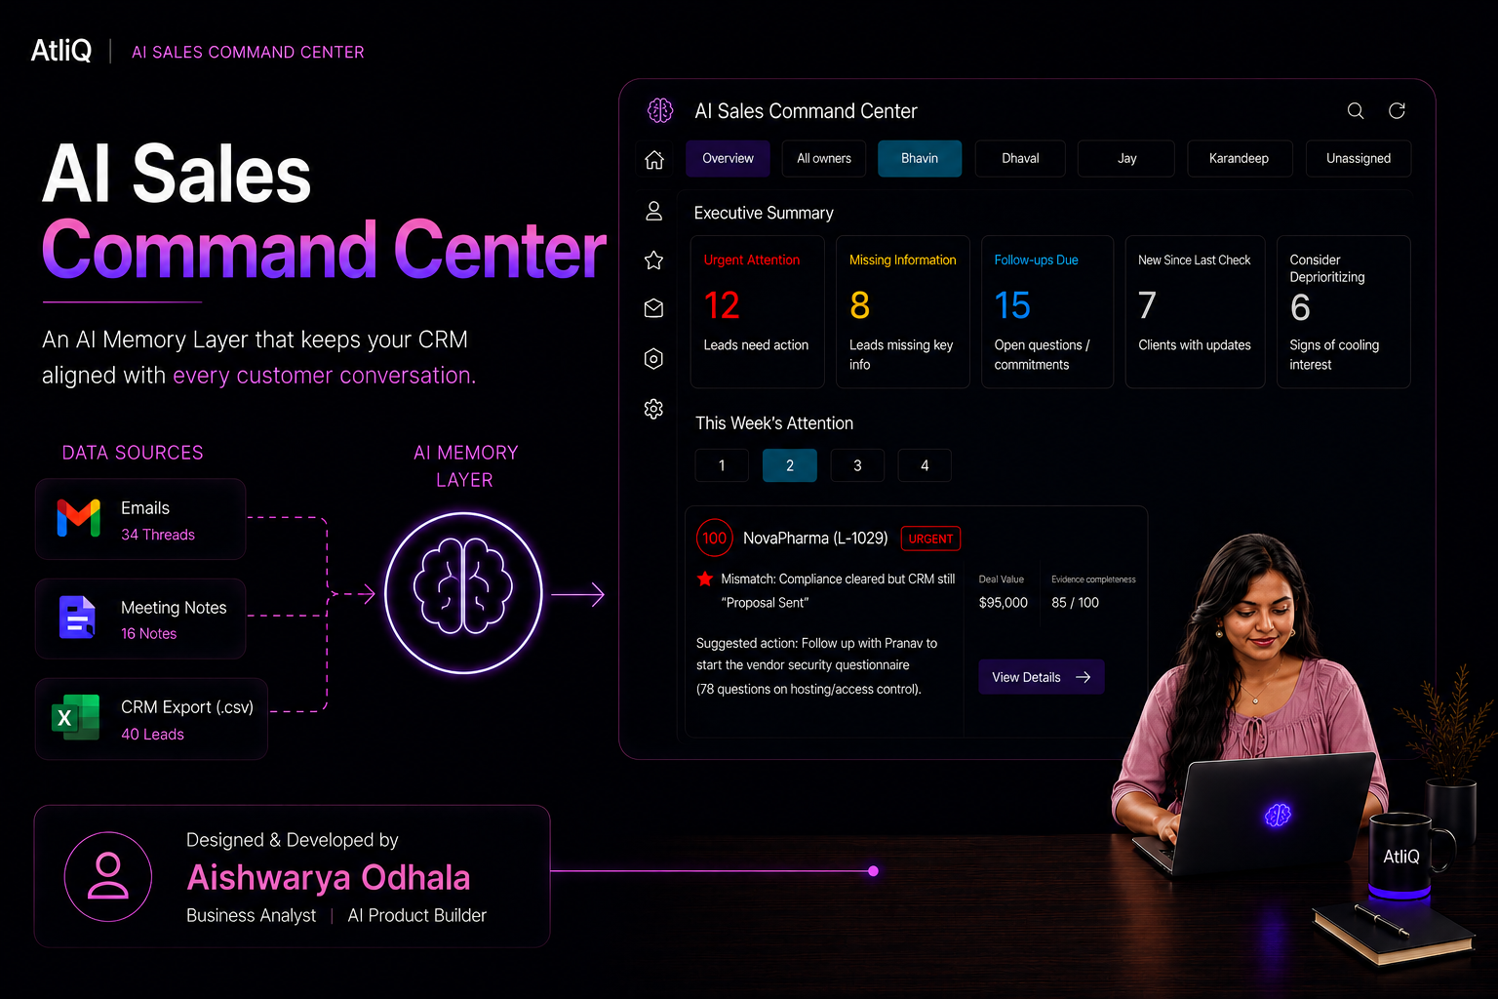

Slide 2


AtliQ
WHERE WE'RE HEADED
Agenda
Five stops, one story.
1
The Problem
Why sales teams lose deals — and what's really going on underneath
2
The Investigation
Real evidence, the root cause, and the decision it led to
3
The Design
How the AI was scoped, guarded, and chosen on purpose
4
The Proof
Real cost, real metrics, and where this approach hits its limits
5
The Product
A feature tour — then the live demo
02 / 14

Slide 3

AtliQ
A QUESTION WORTH SITTING WITH
Why Do Sales Teams
Lose Deals?
Ask most people, and you'll get the wrong answer.
03 / 14

Slide 4

AtliQ
IT'S NOT EFFORT. IT'S FRAGMENTATION.
The Truth About a Deal Lives
in Three Different Places.
CRM
✕
EMAIL
✕
MEETING NOTES
None of them talk to each other. So the CRM goes stale while the deal keeps moving.
04 / 14

Slide 5
AtliQ
THE INVESTIGATION BEGINS
I Went Looking for Where the Story Breaks
Real emails. Real meeting notes. Nothing invented.
BHAVIN · 30 MARCH
"All three documents attached… let me know if compliance needs anything else."
A complete, professional reply — the kind that should close a deal.
30 Mar
19 Jun
10 Jul
Email sent
Compliance clears
— client ready
Still no reply
05 / 14

Slide 6
AtliQ
WHAT WAS REALLY GOING WRONG?
Five Whys, One Honest Answer
1
Deals go cold
↓
2
Follow-ups don't fire on time
↓
3
The CRM doesn't reflect reality
ROOT CAUSE
↓
4
Nobody has time to transcribe every call
The CRM only captures what a busy deal owner remembers to type in.
↓
5
Sales is founder-led — CRM upkeep is sacrificed first
Revenue leaks from a lack of memory — not a lack of leads.
06 / 14

Slide 7
AtliQ
TURNING RESEARCH INTO PRODUCT DECISIONS
What Kind of Tool Would Actually Help?
THE OBVIOUS TOOL
WHAT I BUILT INSTEAD
✕ Auto-updates the CRM
✓ Read-only — never writes to the CRM
✕ Auto-sends follow-ups
✓ Drafts only — a human sends
✕ Black-box confidence scores
✓ Every claim cites a real quote
✕ Acts the moment it's “sure”
✓ Suggests. Never decides.
Fast to build. Impossible to trust.
Slower to build. Something a founder can actually rely on.
07 / 14

Slide 8
AtliQ
DESIGNING THE AI EXPERIENCE
Every Capability Ships With Its Guardrail
Not a checklist bolted on after — designed in from the start.
Extracts facts from raw email & note text
→
Grounded Attribution — must cite a verbatim quote, or it's dropped
Drafts a follow-up email, evidence-grounded
→
Human Control — nothing sends without a click
Summarizes the whole pipeline in seconds
→
Explainability — every summary traces back to source docs
Scores urgency & flags duplicates
→
Fairness & Privacy — business signals only, never personal data
08 / 14

Slide 9
AtliQ
MODEL STRATEGY
The Simplest Path That Still Holds Up
Three options. One made sense at this scale.
ELIMINATED
ELIMINATED
CHOSEN
Fine-Tuning
RAG / Embeddings
Prompt + Structured Output
(Claude Sonnet 5)
No labelled data yet to do it responsibly
Each lead's documents are small enough to pass in full
Strong grounding & schema-constrained output — nothing more was needed
09 / 14

Slide 10
AtliQ
MODEL STRATEGY · LOOKING AHEAD
When Does This Stop Being Enough?
Three specific triggers — not a guess.
TRIGGER
TRIGGER
TRIGGER
A single lead outgrows
one context window
The question becomes
cross-lead, not per-lead
Enough real usage data
accumulates
THEN →
THEN →
THEN →
Add retrieval (RAG) — but only for that lead's documents, not a portfolio-wide rebuild
“Who mentioned a competitor this quarter?” needs search across leads — a dedicated insights layer, not a one-off prompt
Revisit fine-tuning — once human-agreement data exists to train on responsibly
None of this is hypothetical — every trigger here is already staged in the PRD's own roadmap.
10 / 14

Slide 11
AtliQ
CAN THIS ACTUALLY WORK IN PRODUCTION?
The Business Case, in Real Numbers
Not a projection — this is measured, from actual billing.
$4.85
99.4%
159.8x
Monthly AI cost
Cheaper than
manual review
Return on every
$1 spent
$4.85/month to run this for AtliQ's full pipeline vs. ~$779/month in founder & rep time doing it by hand.
The cost of catching a stalled deal is smaller than the cost of one missed reply.
11 / 14

Slide 12
AtliQ
CLOSING THE LOOP
How We'll Know It Worked
Back to the question we opened with — one number, held up by three others.
TARGET → 0
NORTH STAR
High-value leads (>$50k), 30+ days silent despite real engagement
OUTPUT · SHALLOW
TRUST SIGNAL
GUARDRAIL METRIC
Findings surfaced per run; suggested actions generated
Human agreement with flagged findings; actions used as-is vs. edited vs. discarded
Rate of findings dropped by the grounding check; automated CRM writes or sent emails
Directional only — tracked, not targeted
≥ 80% agreement
Writes/sends must stay at 0
12 / 14

Slide 13
AtliQ
BRINGING THE SOLUTION TO LIFE
One Idea, Eleven Ways It Shows Up
This Week's Attention
Full Reasoning Trail
Draft Follow-Ups
Every urgent lead, ranked and explained
No black box — every score, explained
One click. Nothing sends itself.
Effort vs. Payoff
Drill Into a Lead
Executive Summary
Zero AI calls — pure CRM math
The whole story, chronologically
The pipeline's health, in one paragraph
+ 5 more inside the live product — categories, hidden opportunities, linked evidence, memory trail, and the floating assistant.
13 / 14

Slide 14

From Question to Proof
Let's See It Live
READ-ONLY
EVIDENCE-GROUNDED
HUMAN-APPROVED, ALWAYS
ai-sales-command-center-5srun5kqnywjo2wb4dfy3u.streamlit.app
Prepared by Aishwarya Odhala · Business Analyst, AI Product Builder

